Slide 1
Open Vietnamese Restaurant
In Amsterdam
Assignment Project Week 2

Slide 2
Background
Nowadays, there is a trend about Vietnamese food in some big cities in Europe. Vietnamese food has many interesting aspects: various cooking methods, various ingredients and good health. I think that ‘s why many European people love Vietnamese food. Besides that, many Vietnamese people live and develop their career in Europe so they want to find real Vietnamese food. It ‘s both a chance and a challenge. One of the European cities which many Vietnamese people live is Amsterdam - a beautiful city of Netherlands. We plan to open a Vietnamese restaurant in Amsterdam.

Slide 3
Problem
As I said, there is a large proportion of Vietnamese population in Amsterdam. It means there are many Vietnamese restaurants. To challenge them, there are 2 key points: choosing location and delivering good quality. Many high rating restaurants are located in the same area of Amsterdam. I want to find a location which is suitable for opening Vietnamese restaurant but it ‘s better if there are less good restaurants in that location.

Slide 4
Data
Boroughs in Amsterdam: https://en.wikipedia.org/wiki/Boroughs_of_Amsterdam
Latitude and Longitude values are obtained by using "geocoder"
All restaurants data related to locations are obtained by using Foursquare API:
  Find areas which have many Asian restaurants that were rated from 1 - 3 stars

Slide 5
Methodology
Master data which includes “Neighbourhoods”, “Latitude” and “Longitude” information of Amsterdam.
Python Folium library was used to visualize map of Amsterdam and its neighbourhoods. In order to get Latitude and Longitudes of Amsterdam, geopy and geocoder are used. The map below was obtained.
In order to explore places Foursquare API was used. Limit was set to 100 and Radius was set to 500.
Using Foursquare API to explore venues in category “Asian Restaturant” then sort top 50 neighbourhoods which has most Asian Restaurants

Slide 6
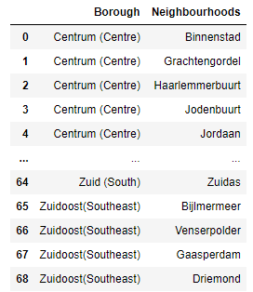
Step 1
Use Beautiful Soup to get all of neighbourhoods in Amsterdam from Wiki: https://en.wikipedia.org/wiki/Boroughs_of_Amsterdam

Slide 7
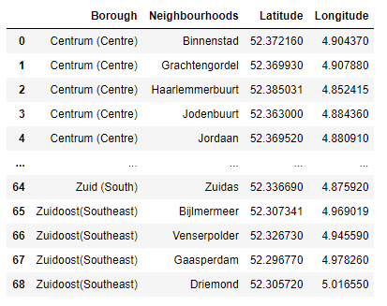
Step 2
Use Geocoder to get Lat, Long per each Neighbourhood

Slide 8
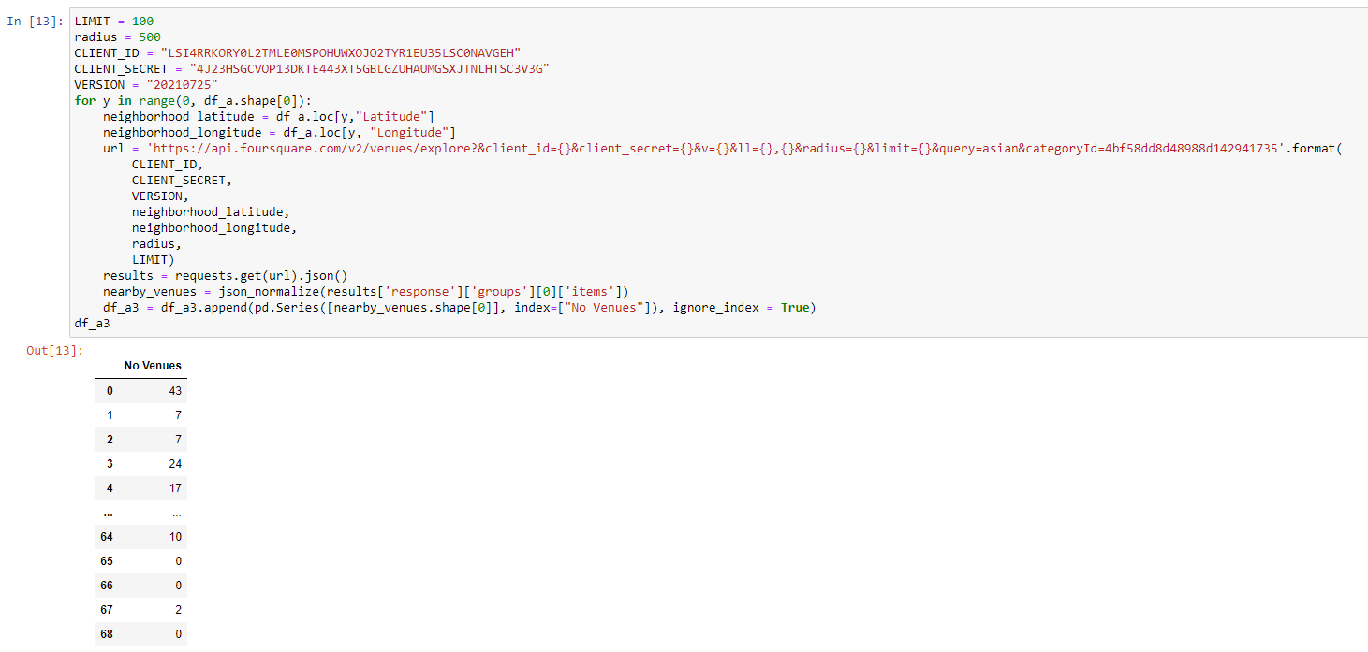
Step 3
Use Foursquare API to get Venues in category “Asian Restaurant” in each Neighbourhoods

Slide 9
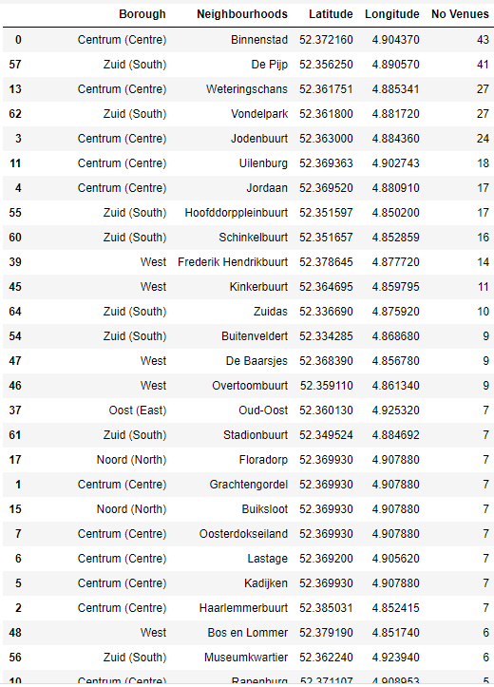
Step 4
Sort by No of Venues then get top 50

Slide 10
Step 5
Sort by No of Venues then get top 50

Slide 11
Step 6
There are common venues in neighbourhoods, so unsupervised K-means algorithm was used to cluster districts. K-Means cluster was set to 5 clusters, to reach optimum accuracy.
Cluster 0: < 6 venues
Cluster 1: > 41 venues
Cluster 2: 14 - 18 venues
Cluster 3: 6 - 11 venues
Cluster 4: 24 - 27 venues

Slide 12
Results
We decide to choose Neighbourhoods in Cluster 3:
There are about >5 venues so customers are quite familiar to Asian foods
There are the second in total neighbourhoods of each Cluster

Slide 13
